Slide 1
Business insights to US Power Plants
Snehitha Anpur
Graduate Student – MSBA
Kent State University

Slide 2
Problem Statement
The objective of Power plants is to provide reliable and economical energy to their consumers while minimizing their impact on the environment.
The goal is to analyze and find the methods to improve efficiency, reduce emissions, satisfying customer demands and be competitive in the market.

Slide 3
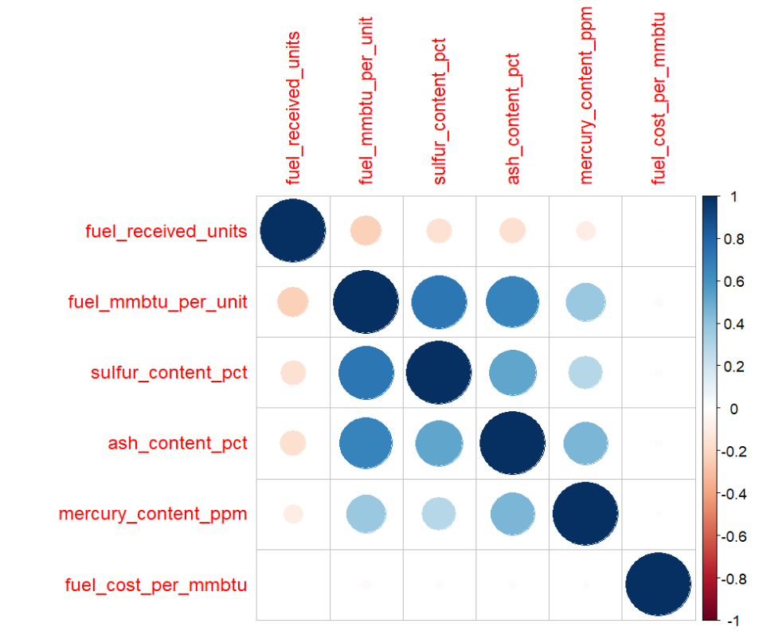
Data Description
Dataset has 24 Attributes
Fuel MMBtu is highly correlated with Sulphur content and Ash content
Over the Years proportion of Usage of Coal is decreasing and Natural gas is Increasing
Natural gas has mostly of spot purchases
Over the Years transportation using Pipeline is increasing and Railways are decreasing

Slide 4
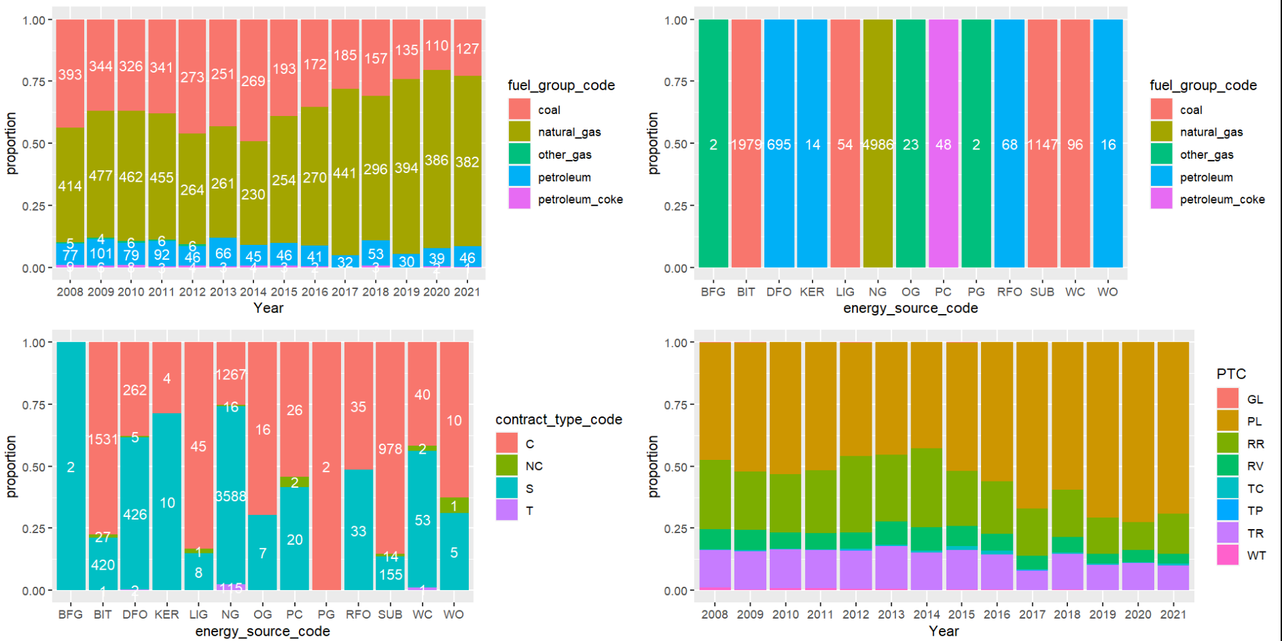

Slide 5
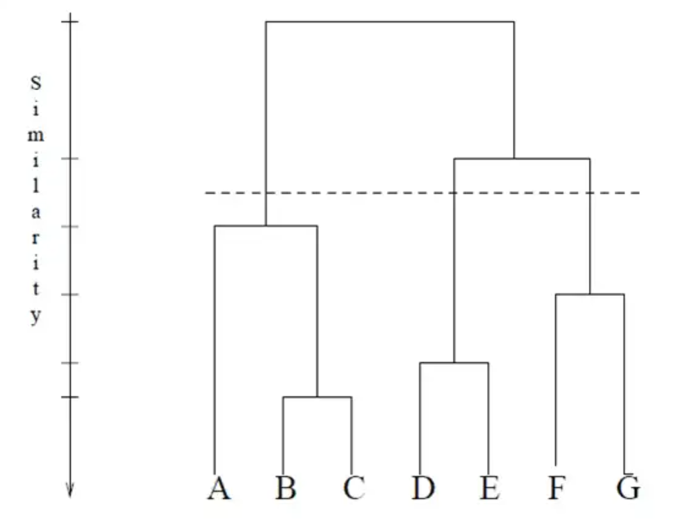
Clustering Analysis
Hierarchical
Optimal Number of Clusters : 7
Better interpretation
It produced clusters of high homogeneity within clusters
Better model over K-Means and DB Scan for this data

Slide 6
Discussions
Cluster 1
These Power plants utilize mostly Natural Gas and Petroleum
Cluster 2
Power plants produce higher CO2 contents as they use BIT, LIG, SUB and PC
Cluster 3
These Power plants have high number of fuel received units
High fuel cost and many spot purchases
Suppliers to these plants provide better quality coal which have less emissions
Low fuel cost and many contracts and spot purchases
Less polluting Power Plants due to zero Ash, Sulphur and Mercury content
Suppliers to these plants provide cheaper Natural Gas than Cluster 1 suppliers
Majority of the plants use Pipe Line as primary transportation

Slide 7
Analysis and Discussion
Cluster 4
Coal based plants with lowest fuel cost and are contract purchases
Cluster 5
Majority of the purchases are new contracts
Cluster 6
All purchases are contract based and the primary transportation is only Truck
Cluster 7
High polluting with highest Sulphur, Mercury and Ash content
Majority of the plants use Railways as primary transportation and high sulphur content
For same BIT Coal fuel cost of Clusters 3 and 4, the emissions are high for coal and ash
Highest heat content with high sulphur and mercury content
Lowest fuel received units and BIT coal cost same as clusters 3 and 4

Slide 8
Conclusion and Summary
The plants in Cluster 1 can switch to suppliers from Cluster 3 where the Natural Gas and Petroleum cost is cheaper to improve profits
The plants in Cluster 2 can restrict to using BIT Coal to reduce CO2
Better Suppliers: The Clusters 3 and 4 are primarily Coal based, the emissions are lower and cost is cheaper
Least recommend Suppliers of Clusters 5, 6 and 7 providing low quality Coal
Decrease the spot purchases of fuel
Cluster 3 and 4 has less cost and less emissions which is economical and can reduce the impact on environment

